Slide 1

Rainfall Prediction System

Slide 2
Guided By: Dr. Vivek N. Waghmare
Presented By:
Jay Jadhav (B150614248)
Sharmil Adroja (B150614201)
Krishna Avhad (B150614208)

Slide 3
Outline
Introduction
Data Sets Used
Types of rainfall prediction
Types of graph used
Methodology
Results
Conclusions

Slide 4
Introduction
Monsoon prediction is clearly of great importance for India.
Indian meteorological department provides forecasting data required for project.
In this project we have worked on long term predictions of rainfall.
The main motive of the project is to predict the amount of rainfall in a particular division or state well in advance.
We predict the amount of rainfall using past data.

Slide 5
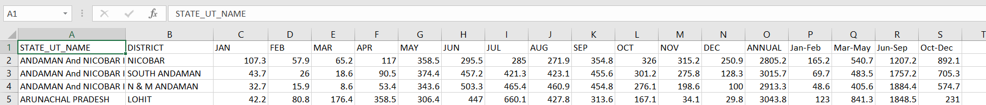
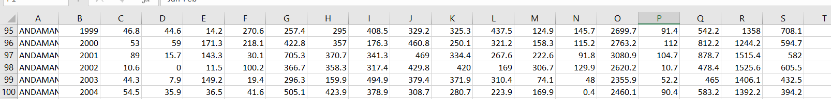
Data Sets Used
Dataset1(Fig.1) This dataset has average rainfall from 1951-2015 for each district, for every month.
Dataset2(Fig.2) This dataset has average rainfall for every year from 1901-2015 for each state.
FIG.1
FIG.2

Slide 6
Predicting total monsoon rainfall (1901 - 2015)
Predicted by using its correlation with observed parameters value.
The predictions keep changing with time if new data is been updated.
Regression based model is used to simple analyze and visualize the overall rainfall.

Slide 7
Types of rainfall prediction
One would like to make:
Long term prediction: Long term prediction means to predict total monsoon rainfall a few weeks or months in advance.
Short term prediction: Short term prediction means to predict rainfall over different locations a few days in advance.

Slide 8
Types of graph used
Bar graphs showing distribution of amount of rainfall.
Distribution of amount of rainfall yearly, monthly, groups of months.
Distribution of rainfall in subdivisions, districts form each month, groups of months.

Slide 9
Methodology
Converting data in to the correct format to conduct experiments.
Make a good analysis of data and observe variation in the patterns of rainfall.
By using various approaches we try to find where the rain will appear most.

Slide 10
Result’s

Slide 11
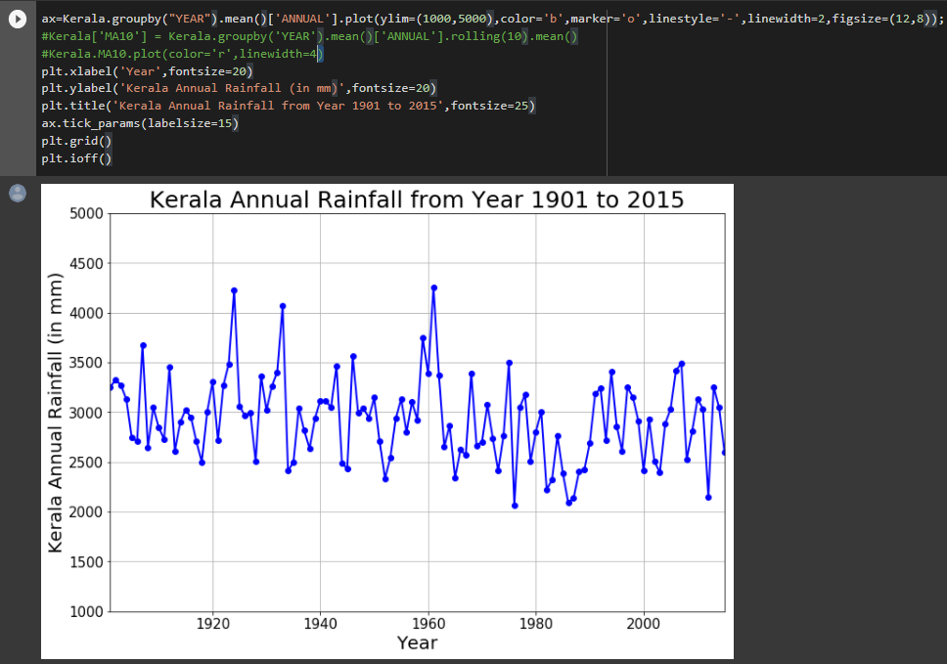
Kerala Annual Rainfall from year 1901 to 2015

Slide 12
Conclusions
Various visualizations of data are observed which helps in implementing the approaches for prediction.
Prediction of amount of rainfall for both the types of dataset.
Observations indicates machine learning models won’t work well for prediction of rainfall due to fluctuations in rainfall.

